Slide 1

Physics Engine

Slide 2
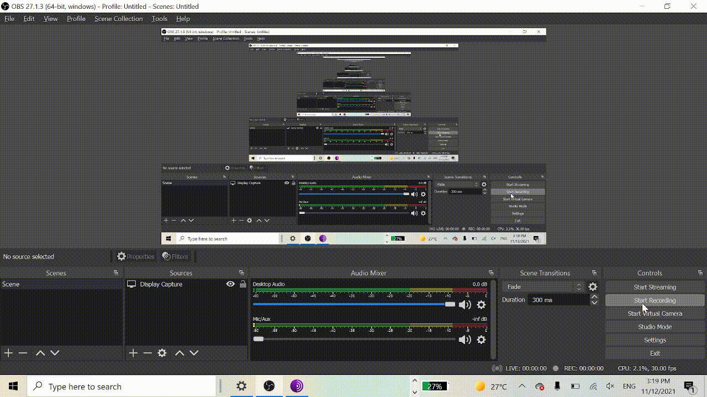
The first projected that has been selected and created is a physics simulator with customizable settings for, gravity, ball mass, friction, ball size and map etc. (Seen in figure 1)
The program uses python to create virtual spaces and
objects using a pip installation called pymunk and pyglet
these programs are created and used by the community
to create various different projects and games.
The program has customizable maps that are made by
by using numbers for the parameters

Slide 3
The Maths
The plugins used in this base the environment and gravity on real life, this means it uses the standard 9.8m/s for the acceleration of an object on earth. Galileo first postulated the concept of inertia in the 17th century, and in his first law of motion, Sir Isaac Newton further developed Galileo’s observations. According to the first law, without the intervention of an external force, objects in motion will continue to move at the same speed in a straight line. Objects at rest, on the other hand, will remain at rest unless an external force moves them. This tendency to resist changes in motion is known as “inertia,” and it is directly related to the object’s mass. The more massive an object is, the more it resists changes in its motion.
This program has also uses momentum, which uses newtons second law, which states that Fnet = ma, this means that the higher mass the objects are the faster they will gain speed on a slope, therefore when changing the mass in the program increases the rate that the balls gain speed.
The friction multiplier increases the friction on the objects, thus making the balls lose speed faster,

Slide 4
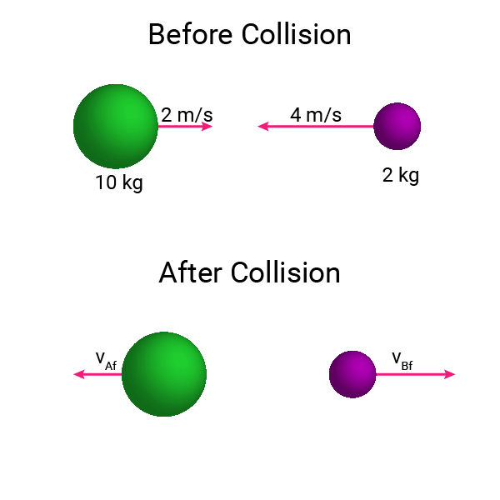
Maths Cont.
When changing the elasticity within the program changes how much energy is lost when the ball connects with another object. Increasing the elasticity affects how little energy is lost when hitting another ball, so if you have high elasticity when the balls hit each other they will keep energy, but a lower elasticity increases the amount of energy lost.
The program has the option to increase or decrease the gravity value, at standard it is 1000, which is 10m/s , when increasing this value will increase the amount of force applied on the balls. This will then increase the speed that the balls will fall.

Slide 5
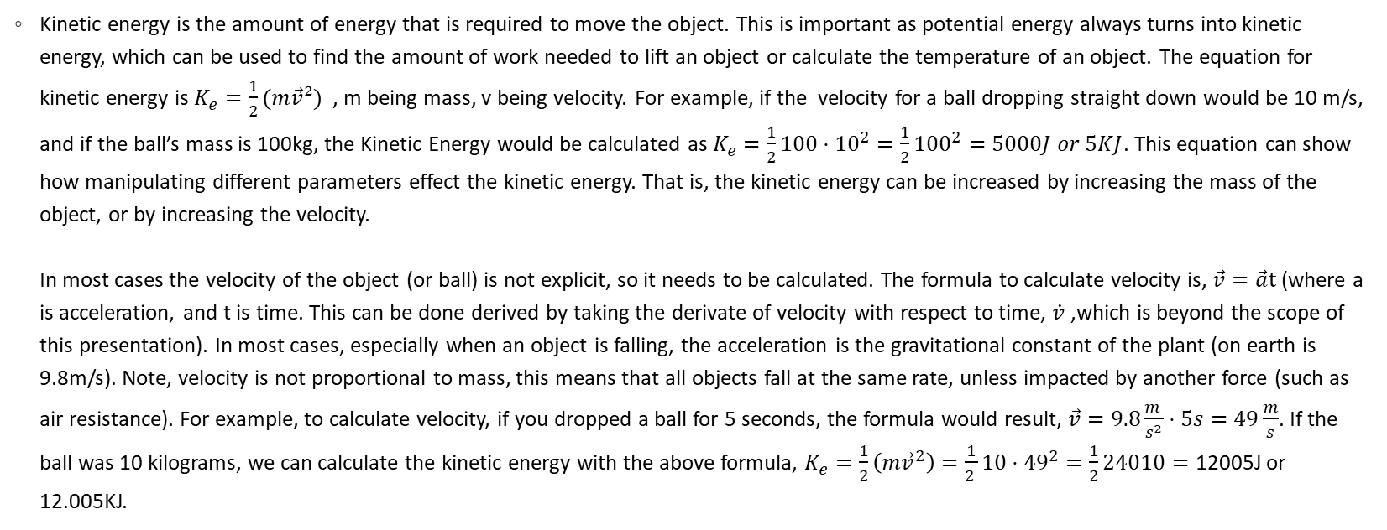
Kinetic Energy of a Falling Ball
Kinetic energy is the amount of energy that is required to move the object. This is important as potential energy always turns into kinetic energy, which can be used to find the amount of work needed to lift an object or calculate the temperature of an object. The equation for kinetic energy is $K_{e}=\frac{1}{2}(m\vec{v}²)$, m being mass, v being velocity. For example, if the velocity for a ball dropping straight down would be 10 m/s, and if the ball’s mass is 100kg, the Kinetic Energy would be calculated as $K_{e}=\frac{1}{2}100⋅{10}^{2}=\frac{1}{2}{100}^{2}=5000J or 5KJ$. This equation can show how manipulating different parameters effect the kinetic energy. That is, the kinetic energy can be increased by increasing the mass of the object, or by increasing the velocity. In most cases the velocity of the object (or ball) is not explicit, so it needs to be calculated. The formula to calculate velocity is, $\vec{v}=\vec{a}t$ (where a is acceleration, and t is time. This can be done derived by taking the derivate of velocity with respect to time, $\dot{v}$ ,which is beyond the scope of this presentation). In most cases, especially when an object is falling, the acceleration is the gravitational constant of the plant (on earth is 9.8m/s). Note, velocity is not proportional to mass, this means that all objects fall at the same rate, unless impacted by another force (such as air resistance). For example, to calculate velocity, if you dropped a ball for 5 seconds, the formula would result, $\vec{v}=9.8\frac{m }{s^{2}}⋅5s=49\frac{m}{s}$. If the ball was 10 kilograms, we can calculate the kinetic energy with the above formula, $K_{e}=\frac{1}{2}\left(m{\vec{v}}^{2}\right)=\frac{1}{2 }10⋅{49}^{2}=\frac{1}{2}24010=\text{12005}\text{J} \text{or}\text{ 12.005}\text{KJ}$.

Slide 6
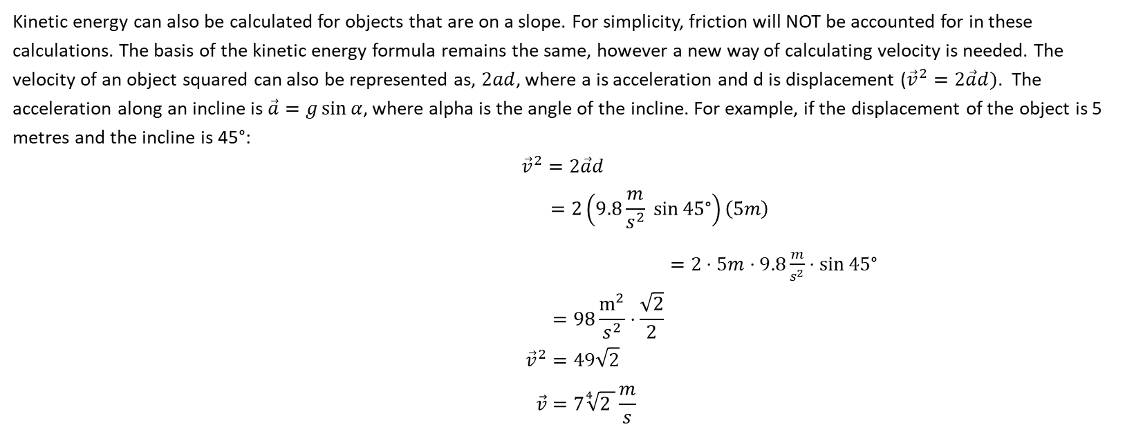
Kinetic Energy on an incline
Kinetic energy can also be calculated for objects that are on a slope. For simplicity, friction will NOT be accounted for in these calculations. The basis of the kinetic energy formula remains the same, however a new way of calculating velocity is needed. The velocity of an object squared can also be represented as, $2ad$, where a is acceleration and d is displacement (${\vec{v}}^{2}=2\vec{a}d)$. The acceleration along an incline is $\vec{a}=g\sin{α}$, where alpha is the angle of the incline. For example, if the displacement of the object is 5 metres and the incline is 45°: ${\vec{v}}^{2}=2\vec{a}d$ $$=2\left(9.8\frac{m}{s^{2}} \sin{45\text{°}}\right)\left(5m\right)$$
$=2⋅5m⋅9.8\frac{m}{s^{2}}⋅\sin{45\text{°}}$
$$=98\frac{m^{2}}{s^{2}}⋅\frac{\sqrt{2}}{2}$$
$${\vec{v}}^{2}=49\sqrt{2}$$
$$\vec{v}=7\sqrt[4]{2 }\frac{m}{s}$$

Slide 7
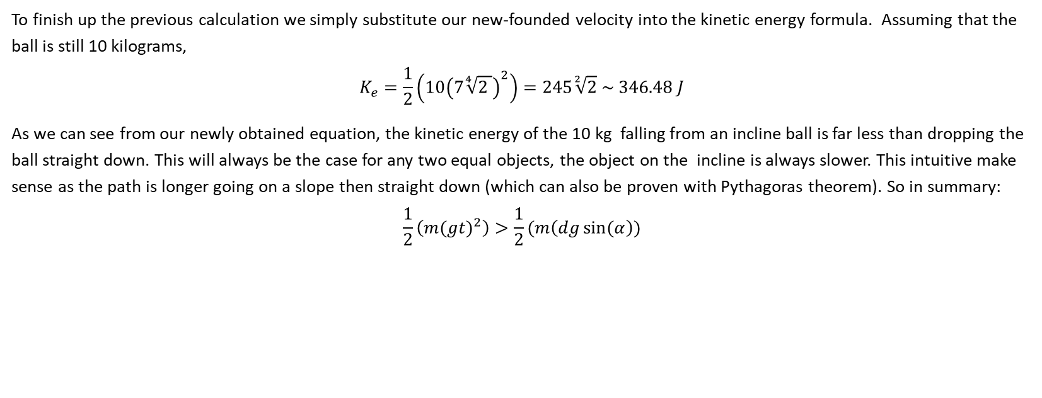
Previous Continued.
To finish up the previous calculation we simply substitute our new-founded velocity into the kinetic energy formula. Assuming that the ball is still 10 kilograms,
$$K_{e}=\frac{1}{2}\left(10{\left(7\sqrt[4]{2 }\right)}^{2}\right)=245\sqrt[2]{2} \sim 346.48 J$$
As we can see from our newly obtained equation, the kinetic energy of the 10 kg falling from an incline ball is far less than dropping the ball straight down. This will always be the case for any two equal objects, the object on the incline is always slower. This intuitive make sense as the path is longer going on a slope then straight down (which can also be proven with Pythagoras theorem). So in summary:
$$\frac{1}{2}\left(m{(gt)}^{2}\right)>\frac{1}{2}(m\left(dg\sin{(α}\right))$$

Slide 8
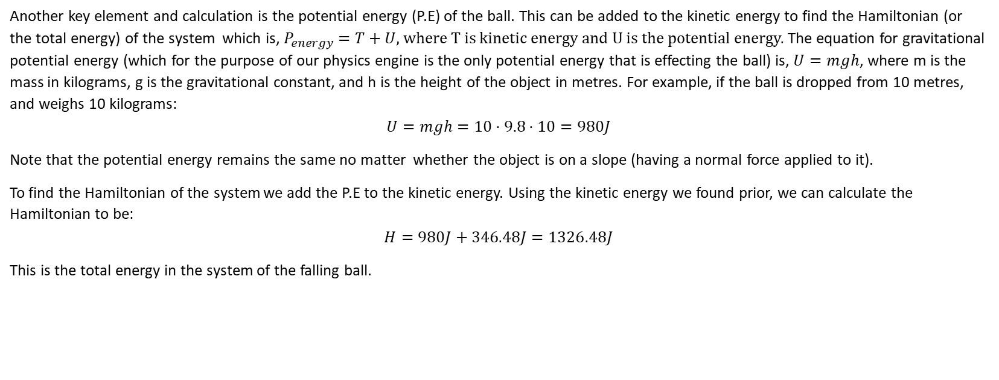
Potential Energy and the Hamiltonian of a Falling Ball
Another key element and calculation is the potential energy (P.E) of the ball. This can be added to the kinetic energy to find the Hamiltonian (or the total energy) of the system which is, $P_{energy}=T+U,$ where T is kinetic energy and U is the potential energy. The equation for gravitational potential energy (which for the purpose of our physics engine is the only potential energy that is effecting the ball) is, $U=mgh$, where m is the mass in kilograms, g is the gravitational constant, and h is the height of the object in metres. For example, if the ball is dropped from 10 metres, and weighs 10 kilograms:
$$U=mgh=10⋅9.8⋅10=980J$$
Note that the potential energy remains the same no matter whether the object is on a slope (having a normal force applied to it).
To find the Hamiltonian of the system we add the P.E to the kinetic energy. Using the kinetic energy we found prior, we can calculate the Hamiltonian to be:
$$H=980J+346.48J=1326.48J$$
This is the total energy in the system of the falling ball.

Slide 9
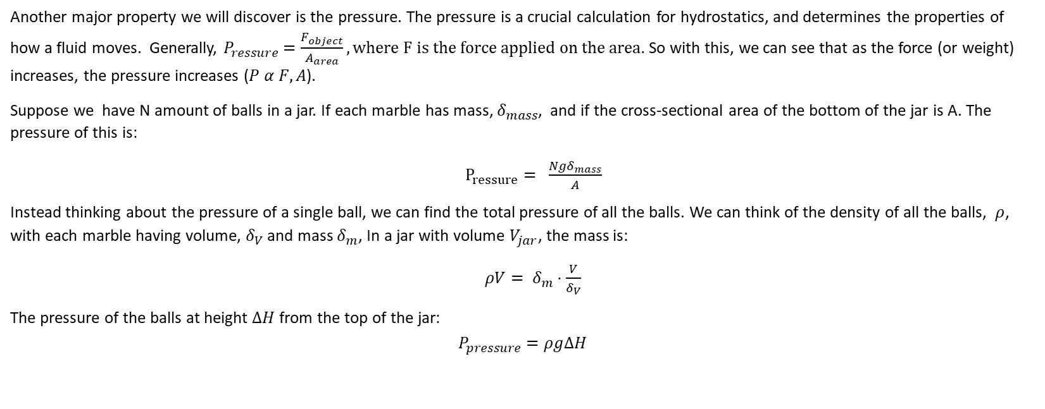
Pressure of a system
Another major property we will discover is the pressure. The pressure is a crucial calculation for hydrostatics, and determines the properties of how a fluid moves. Generally, $P_{ressure}=\frac{F_{object}}{A_{area}}, where F is the force applied on the area.$ So with this, we can see that as the force (or weight) increases, the pressure increases ($P α F, A$).
Suppose we have N amount of balls in a jar. If each marble has mass, $δ_{mass}$, and if the cross-sectional area of the bottom of the jar is A. The pressure of this is:
$P_{ressure}= \frac{Ngδ_{mass}}{A}$
Instead thinking about the pressure of a single ball, we can find the total pressure of all the balls. We can think of the density of all the balls, $ρ$, with each marble having volume, $δ_{V}$ and mass $δ_{m}$, In a jar with volume $V_{jar}$, the mass is:
${ρV= δ}_{m}⋅\frac{V}{δ_{V}}$
The pressure of the balls at height $ΔH$ from the top of the jar:
$$P_{pressure}=ρgΔH$$

Slide 10
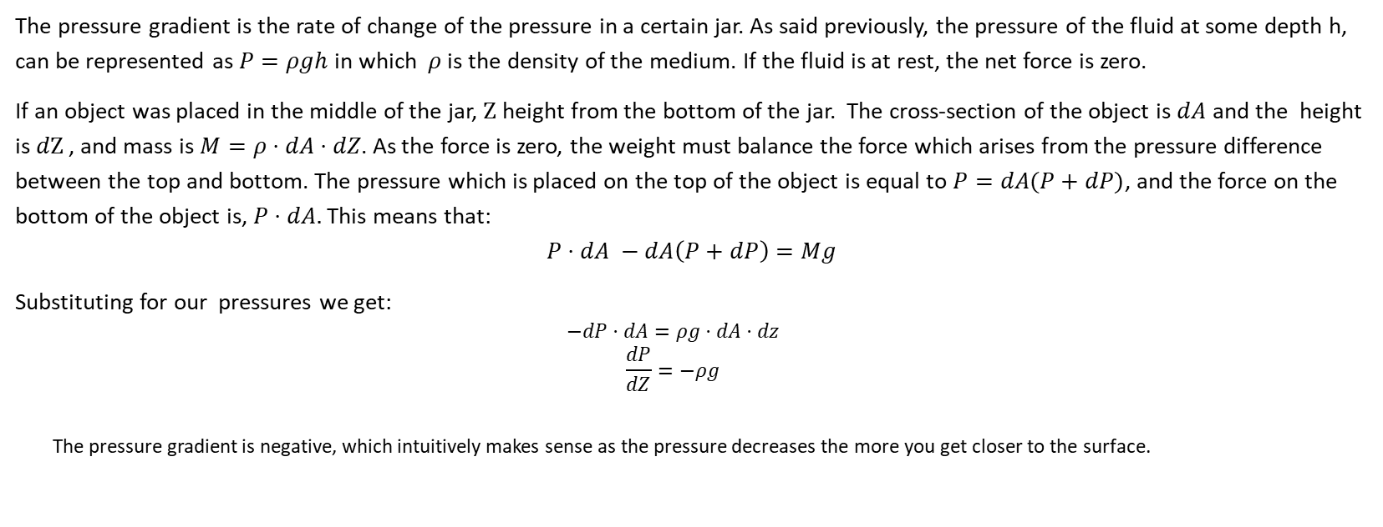
Pressure continued
The pressure gradient is the rate of change of the pressure in a certain jar. As said previously, the pressure of the fluid at some depth h, can be represented as $P=ρgh$ in which $ρ$is the density of the medium. If the fluid is at rest, the net force is zero.
If an object was placed in the middle of the jar, $Ζ$ height from the bottom of the jar. The cross-section of the object is $dA$ and the height is $dΖ$ , and mass is $M=ρ⋅dA⋅dZ$. As the force is zero, the weight must balance the force which arises from the pressure difference between the top and bottom. The pressure which is placed on the top of the object is equal to $P=dA(P+dP)$, and the force on the bottom of the object is, $P⋅dA.$ This means that:
$$P⋅dA −dA\left(P+dP\right)=Mg$$
Substituting for our pressures we get:
$$−dP⋅dA=ρg⋅dA⋅dz$$
$$\frac{dP}{dZ}=−ρg$$
The pressure gradient is negative, which intuitively makes sense as the pressure decreases the more you get closer to the surface.

Slide 11
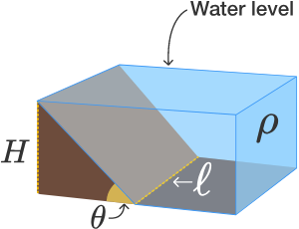

Prev. Cont.
If a liquid is going through at channel, with slanted walls, the force is being applied from the normal force of the slant.
If the $ℓ$, that the slanted walls reach a height of H, and that they slant up from the horizontal at the acute angle $θ$. The channel is filled with water (of density $ρ$) up to the top of the walls.
To find the net force we can use the bulk argument.
$$V=A_{triangle}+ℓ=\frac{1}{2}H⋅\frac{H}{tan⁡(θ)}$$
This exerts a force downwards of:
$$\frac{\frac{1}{2}ρgH^{2}ℓ}{tan⁡(θ)}=F\cos\left(θ\right)$$
$$F=\frac{1}{2}\frac{ρgH^{2} ℓ}{\sin\left(θ\right)}$$
Picture and information for this slide is from brilliant.org, https://brilliant.org/practice/hydrostatics/?p=13

